Slide 1
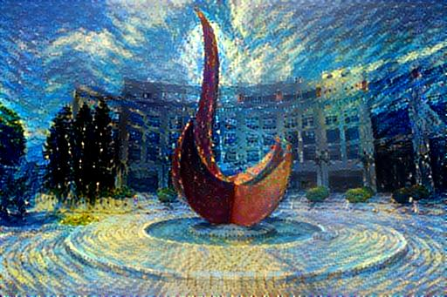
Machine Learning Problems in Cryo-EM
Hanlin Gu, HKUST
2018-11-21

Slide 2
Outline
Introduction for cryo-em
Particle picking problem
Denoising problem
Clustering problem

Slide 3
Experimental techniques to resolve atomic structure
https://www.creative-biostructure.com/comparison-of-crystallography-nmr-and-em_6.html

Slide 4
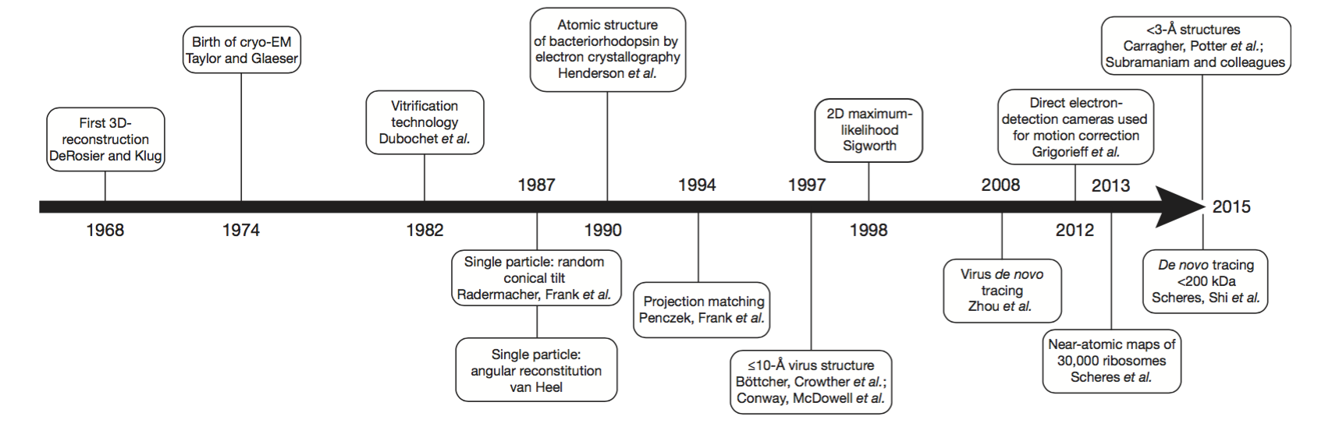
Cryo-EM: Rising star
2012: Resolution Revolution
1974: birth
2017: Nobel Prize

Slide 5
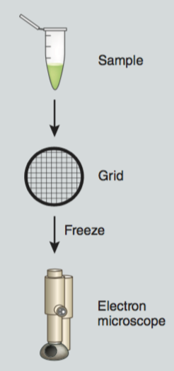
Cryo-EM
Cryo-electron microscopy (cryo-EM), or electron cryomicroscopy, is a form of transmission electron microscopy (TEM) where the sample is studied at cryogenic temperatures (generally liquid nitrogen temperatures ~ 80K).

Slide 6
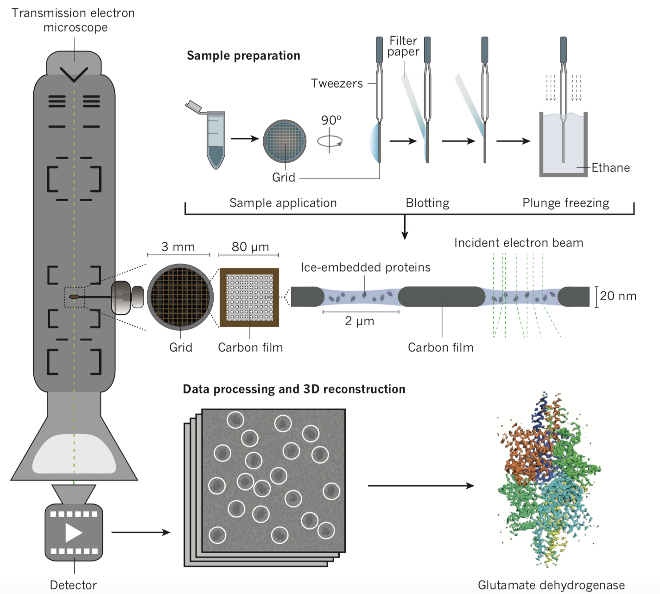
Cryo-EM: ”Take photo” of biomolecular
Structural reconstruction from the micrograph
Rafael Fernandez-Leiro and Sjores H.W.Scheres, Nature, 537(7620), 339-346 (2016)

Slide 7
Photos: Projection of a molecular along a certain direction
Distorted by the non-ideal lens and noises from multiple sources

Slide 8
Experiments vs. Structural Reconstruction
Assign correct angle for each noisy image

Slide 9
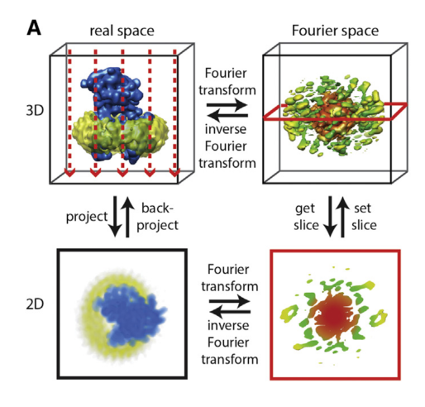
Projection slice theorem
Once we have the correct angles, we can put the slices back and then get the structure
Molecular Cell 58, May 21, 2015

Slide 10
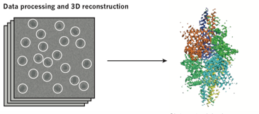
Common protocol

Slide 11

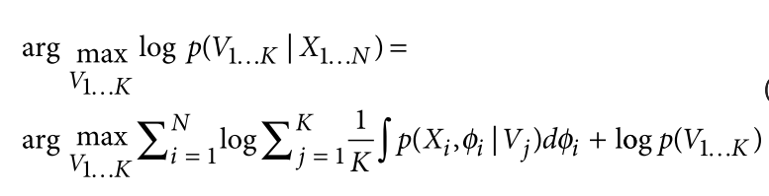
Popular software: cryoSPARC
Maximized posterior probability
Stochastic gradient descend
﻿NATURE METHODS | ADVANCE ONLINE PUBLICATION | 1

Slide 12
Outline
Introduction for cryo-em
Particle picking problem
Denoising problem
Clustering problem

Slide 13
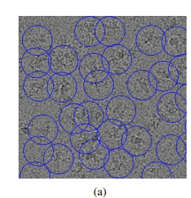
Problem 1: Particle picking
Selection of a tremendous number of (e.g., hundreds of
thousands of) high-quality particles from
micrographs.
This particle picking step is a labor-intensive step,
In the past, particles from cryo-EM micrographs are often
selected manually.

Slide 14
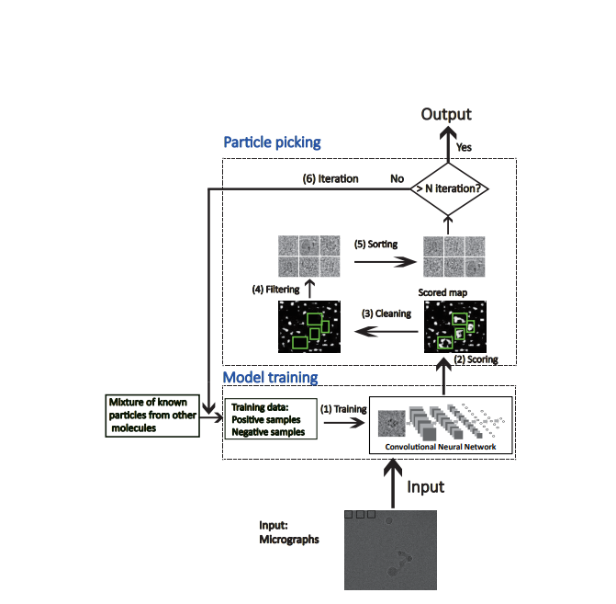
Fully automated particle picking
https://arxiv.org/pdf/1605.01838.pdf

Slide 15
Steps:
Scoring: a sliding window scans micrograph as input data. Getting a score map by cnn.
Cleaning: Remove the pixel point which neighbors(include itself) are all larger than a cutoff.
Filtering: Refine the current set of particle candidates and also identify the center coordinates of the final remaining particles from the scored map.
Sorting: Sort the remaining particle candidates according to their prediction scores.
Iteration：Using the particles picked by the previous CNN classifier which was trained over the known particles of other molecules to further refine the CNN model.

Slide 16
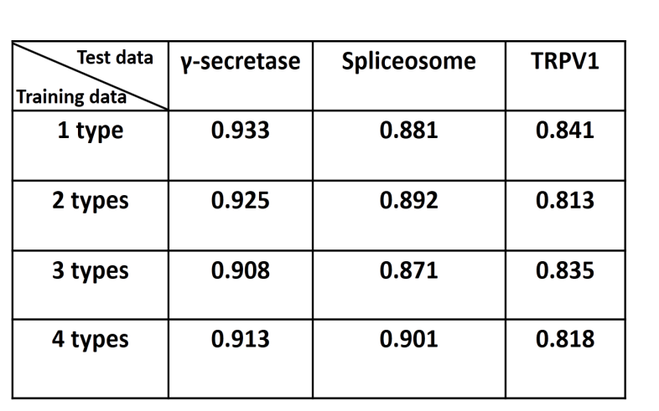
Evaluate
Evaluated the performance of our particle picking approach mainly by comparing the automated picking results to the corresponding reference particles picked manually by human experts

Slide 17
Outline
Introduction for cryo-em
Particle picking problem
Denoising problem
Clustering problem

Slide 18
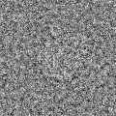
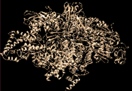
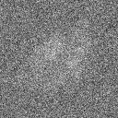
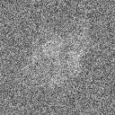
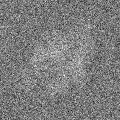
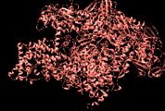
Noise in cryoEM images would obscure the structural differences
Very large noise and unregular
noise
When noise level is comparable with differences between conformations, it is hard to discriminate conformations
Apo ribosome, K2 detector
MSE=0.029
Inter-class diffe ~ intra-class diff
MSE=0.026
Simulated images at SNR=0.1, MSE(X1,X2)=11, var(noise)=39

Slide 19
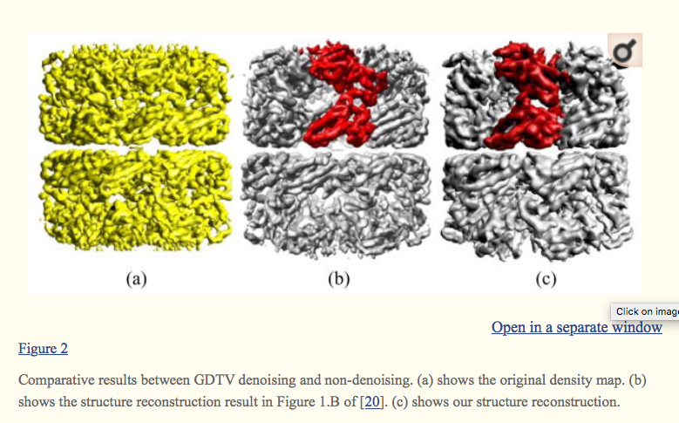
Benefits of denoising
Denoising cryoEM images can
Benefit angular classification
Better distinguish different conformations
Others: improve the performances of common-line detection, improve resolution of reconstructed 3D maps
Far East J Appl Math. 2010 Aug; 45(2): 83–161.

Slide 20
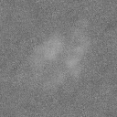
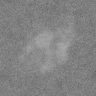
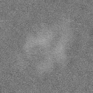
Denoising can benefit discriminating conformations
MSE=0.029
Before denoising
MSE=0.026
MSE=0.0046
After denoising
MSE=0.005
Denoising algorithm: kSVD

Slide 21
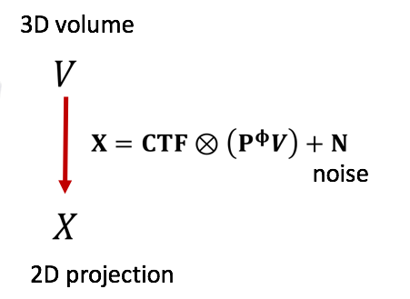
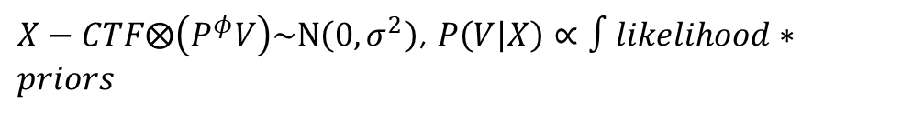
Existing methods in softwares
Existing methods in softwares and challenges
Relion, CryoSPARC: Gaussian noise model, denoising is coupled with the classification process:
Very time consuming and cost a lot of memory
Aspire: Covariance Wiener Filtering (CWF) (Singer, et al.) needs large number of samples in order to have a good denoising performance.
CWF is computational intensive, and not work well with small data samples.
Ensemble method, memory cost is very high
$X−CTF⨂\left(P^{φ}V\right)\sim N\left(0,σ^{2}\right)$, $P\left(V | X\right)∝∫likelihood∗priors$
Notes:
Source of noise: ice
Why low snr? Low dose, since the electron beam would benefit the electron density of molecule, each sample is only used once

Slide 22
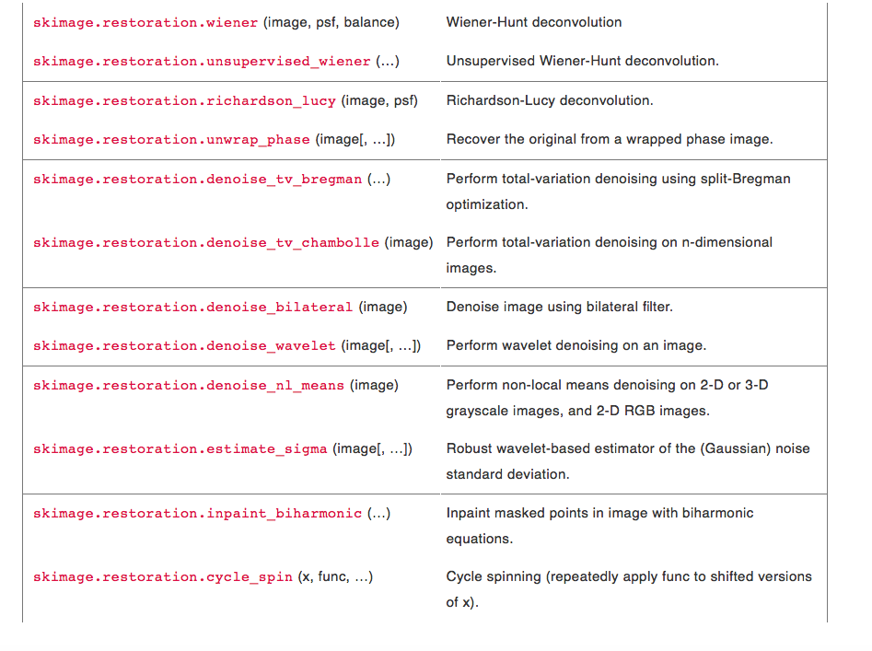
Some other traditional methods
Traditional Wiener Filter
Total variation method: chambolle
Nonlinear local
Mean, median..
http://scikit-image.org/docs/dev/api/skimage.restoration.html
Notes:
Source of noise: ice
Why low snr? Low dose, since the electron beam would benefit the electron density of molecule, each sample is only used once

Slide 23
Some cutting edge methods in applied mathematics
K-SVD
Data-Driven Tight Frame for Multi-Channel Images: DDTF
Block-matching and 3D filtering: BM3D
Notes:
Source of noise: ice
Why low snr? Low dose, since the electron beam would benefit the electron density of molecule, each sample is only used once

Slide 24
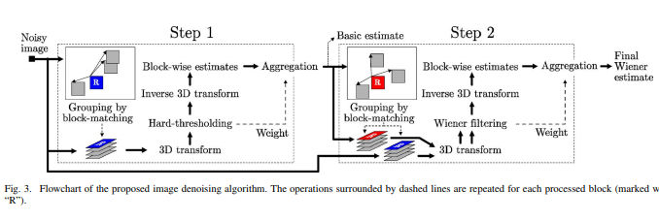
Block-matching and 3D filtering
Finding the image patches similar to a given image patch and grouping them in a 3D block
3D linear transform of the 3D block and set threshold to remove high frequency data;
inverse 3D transformation
Aggregation: average images of block in different weights
https://www.cs.tut.fi/~foi/GCF-BM3D/BM3D_TIP_2007.pdf

Slide 25
K-SVD
In applied mathematics, K-SVD is a dictionary learning algorithm for creating a dictionary for sparse representations, via a singular value decomposition approach.
K-SVD is a generalization of the k-means clustering method, and it works by iteratively alternating between sparse coding the input data based on the current dictionary, and updating the atoms in the dictionary to better fit the data.
Wikipedia: K-SVD
IEEE TRANSACTIONS ON SIGNAL PROCESSING, VOL. 54, NO. 11, NOVEMBER 2006

Slide 26
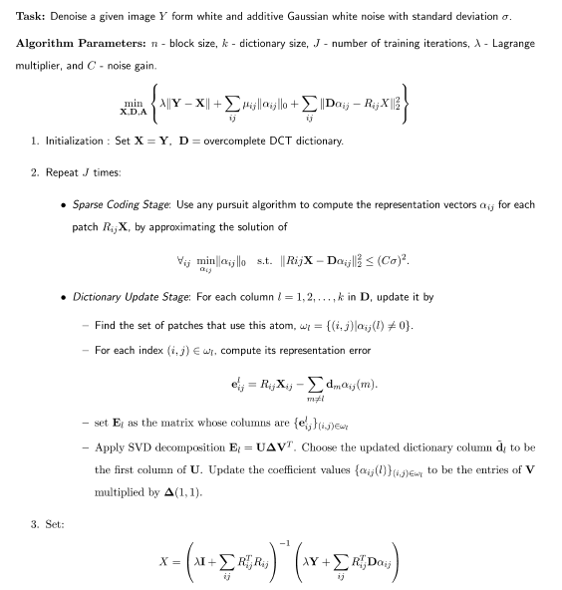
K-SVD
https://sites.fas.harvard.edu/~cs278/papers/ksvd.pdf

Slide 27
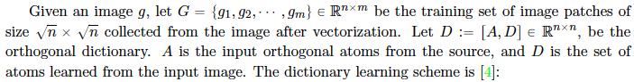
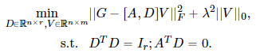
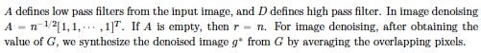
Algorithm proposed: Data Driven Tight Frame (DDTF)
https://www.sciencedirect.com/science/article/pii/S1063520313000924

Slide 28
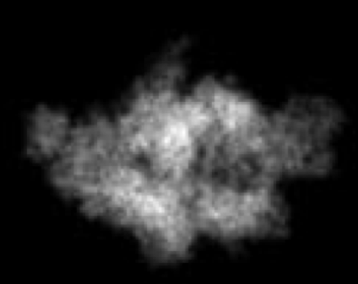
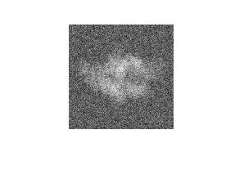
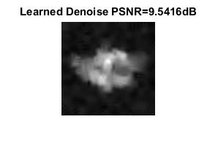
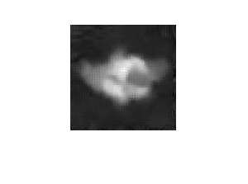

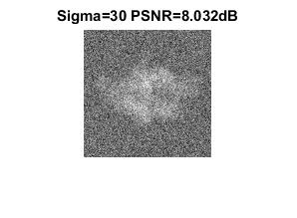
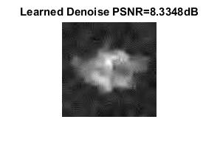
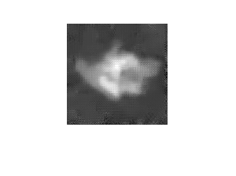
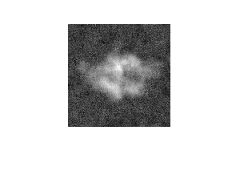
Comparison of the cutting edge algorithms in denoising simulation data
c.f. Clean image
SNR 0.8
DDTF
BM3D
KSVD
SNR 0.4

Slide 29
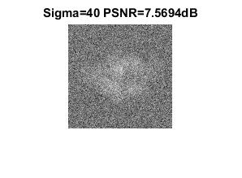
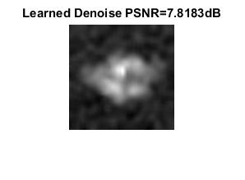
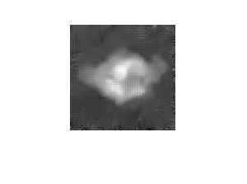

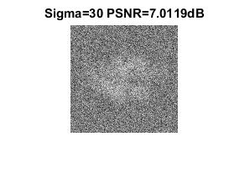
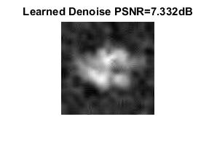

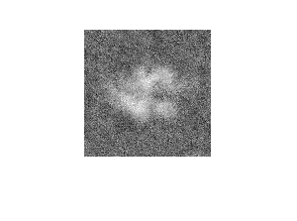
c.f. Clean image
SNR 0.2
Output
DDTF
BM3D
KSVD
SNR 0.1

Slide 30
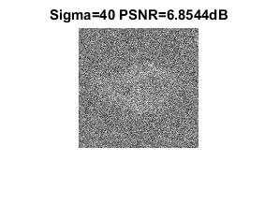
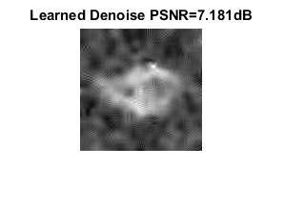
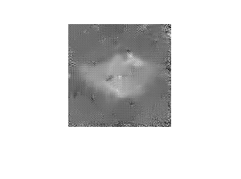
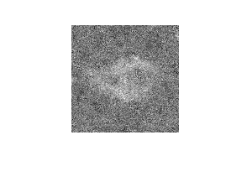
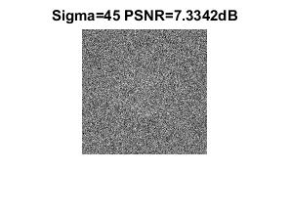
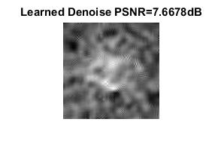
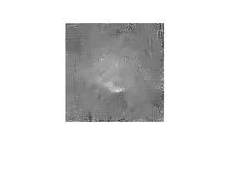
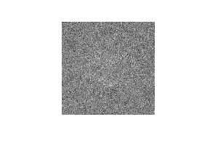
c.f. Clean image
Output
SNR 0.05
DDTF
BM3D
KSVD
SNR 0.01

Slide 31
Performances of CWF in aspire
Covariance Wiener filtering achieves the denoising of an image by Wiener filtering, where the statistical quantities (mean, covariance matrix) are estimated from massive noisy images.
Fast since steerable PCA is applied to reduce the dimensionality
Achieve better performances when the number of noisy images increases.
https://arxiv.org/abs/1602.06632

Slide 32




Performances of CWF vs. # of images
Clean images
SNR=0.01
Denoised results using 1000 images
Cost 2.5G memory
Denoised results using 100 images
Synthetic dataset using P.falciparum 80S ribosome bound to E-tRNA

Slide 33




Performance of CWF vs. SNR
SNR=0.8
SNR=0.4
SNR=0.1
SNR=0.05
Using 2000 images to denoise

Slide 34


Slide 35

The result is bad as the SNR is low

Slide 36

Dataset
1. Choose the first 10000 evidence clean images which from cryosparc.
Sometimes, it is necessary to add contrast transfer function to clean images as reference.
Noisy image = clean image* CTF (in fourier domain)+ noise
Blurring

Slide 37

GAN_structure
https://www.biorxiv.org/content/biorxiv/early/2018/02/12/256792.full.pdf

Slide 38

GAN_structure

Slide 39

Loss function
The g loss and d loss are gradually stable

Slide 40
One criterion: MSE between denoised image and clean image
 | CTF | Non CTF
MSE(test for 500 , train for 9500) | 0.0103 | 0.0046

Slide 41


Result(no ctf):
But the right picture is a little blur, maybe you take some improvements.

Slide 42

Reason for blurring
Deconvolution overlap cause the blur of image

Slide 43

Method
A kernel size that is divided by your stride, avoiding the overlap issue.

Slide 44
Other criterion:
Using software such as cryosparc or relion to reconstruct.
（https://cryosparc.com/docs/tutorials/t20s/）
Using kam theory to reconstruct.
（https://www.ncbi.nlm.nih.gov/pmc/articles/PMC4678003/）
The less the resolution you get, the more accurate result you derive.

Slide 45

The structure after 600 iteration(using cryosparc)

Slide 46
Discussion
Other improvements? Design you own network structure.
Other than GAN, using autoencoder or VAE to denoise the experimental data
Using the multiple images denoising methods taking using of the connections of images.

Slide 47
Outline
Introduction for cryo-em
Particle picking problem
Denoising problem
Clustering problem

Slide 48



Problem 3 :Clustering conformations
str1
str5
Close Open
-153
-149
-144
-140
-136
Choosing ~2000 images from north pole for analysis including 5 equal conformation
Goals: Classify the five conformations that are within same projection angle

Slide 49
Difficulties
With the increasing of conformations, the difference between conformations is less and less.
Because the images are in 2D different angles, how to find a rotational invariant variable becomes a difficulty.
The noise in image will influence the clustering result seriously.

Slide 50
Two-stage Classification of Cryo-EM images
1st ACF classification stage
Fast enough to remove the majority of images (>80%) in full space that are far away from basis set angle efficiently
With space angle error and mis-assignment error during this stage
2nd classification by enhanced basis set stage
Brute force classification of image by pixel information to void space angle error
Remove outliers to obtain the final results
Accurately get the proportion distribution by reducing mis-assignment error

Slide 51

Result
The brute force classification method is better than ACF method, it can

Slide 52


EMBEDDING(ACF function)
There are 3 close conformations which are hard to discriminate.

Slide 53
Discussion
Other clustering methods?
When adding the noise in the images, is it clustering well after denoising?

Slide 54
Thank you!

